Slide 1
Using genome sequencing to identify mutations in evolution experiments
Project Update
05.11.2021

Slide 2
What is genome assembly?
Next generation sequencing
.. TCGTAGC..
GCTACGTAGCTA..
..TCGTAGC..
..GTCGTACGTG..
Genomic DNA
..TTGCTGCATGC..
..TCTCTA..
Millions – billions of reads (30 – 500 bp)
Resequencing
De-novo assembly
Align reads to reference genome and identify variants
Construct genome sequence based on overlaps between reads

Slide 3
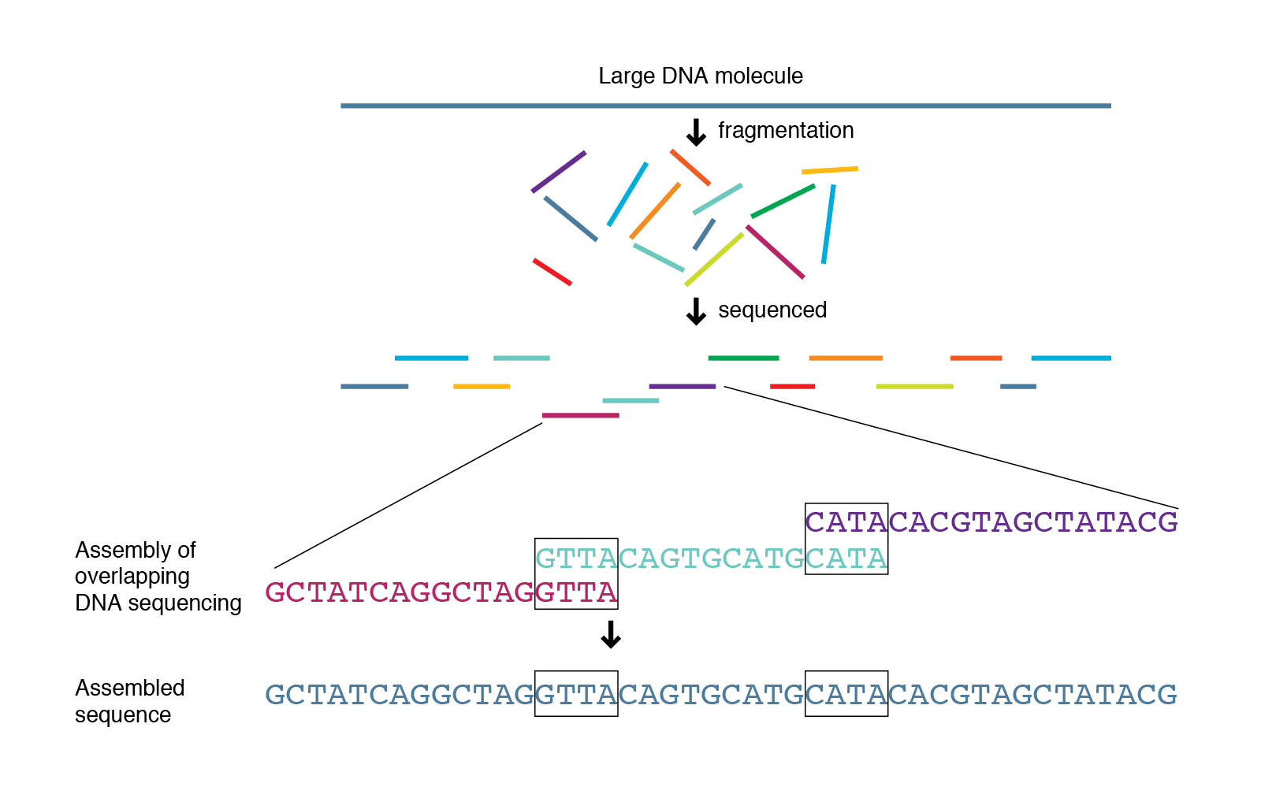
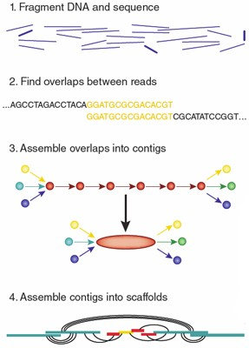
Overview of genome assembly
Areas of research
Improve assembly algorithms
Assemble new genomes
Identify variations in mutant strains
Copy number variation
Insertions / Deletions
Single nucleotide polymorphism
https://www.genome.gov/genetics-glossary/Shotgun-Sequencing

Slide 4
Sequencing technologies
Illumina
< 500 base pair reads
Can do paired end
Millions-billions of reads
Highly accurate, known bias
Relatively even coverage
Cost effective
Repetitive regions
Needs high read depth, based on application (> 50x)
Long Reads
PacBio, Nanopore
1 kb – 100 kb reads
Millions-billions of reads
Long reads
Large coverage, less depth
Expensive
High quality DNA
Error prone, can have systematic errors

Slide 5
Tools for assembly
Alignment steps
Quality check
Alignment
Post alignment analysis
Commonly used aligners
BWA (Burrows-Wheeler Aligner)
bowtie
Subread
Pipelines | Target organisms | Analysis type
Breseq | Prokaryotic, small eukaryotes (Saccharomyces) | Single step analysis
GATK | Originally for human, extended to polyploid organisms | Customizable package with “best-practices” suggestions
SPAdes | All | De-novo assembly

Slide 6
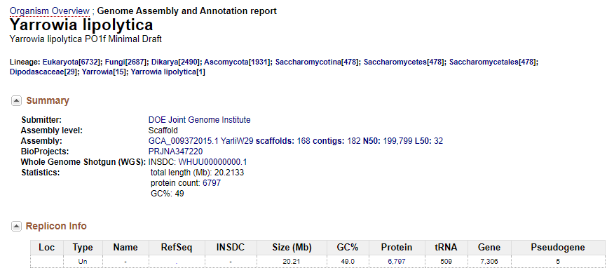
Analysis of evolved mutants in Y. lipolytica PO1f
Parent strain – Yarrowia lipolytica PO1f
Derived from Yarrowia lipolytica W29
Recent genome update: Trinh lab
Experimental work: Sangdo Yook, Jin lab
Strain | Description | Read depth
PO1f | Base strain | 369
16EV | CN evolved from P01f | 386
1EV | CN evolved from P01f | 349
2EV | CN evolved from P01f | 343
41EV | CN evolved from P01f | 319
X123 | P01f + integrated plasmid | 337
XEV | Xylose evolved from X123 | 367
GEV | Glucose evolved from XEV | 369
Walker C, et.al. Draft Genome Assemblies of Ionic Liquid-Resistant Yarrowia lipolytica PO1f and Its Superior Evolved Strain, YlCW001. Microbiol Resour Announc. 2020 Feb, doi: 10.1128/MRA.01356-19

Slide 7
Target output of the analysis
Small (<50 bp)
SNV – single nucleotide (`SNPs`)
◦ Small insertions or deletions (‘Indels’)
Variants vs Errors
distinguish between actual variation (real change) and errors (artifacts) introduced into the analysis
PCR artifacts (amplification of errors)
Sequencing (errors in base calling)
Alignment (misalignment, mis-gapped alignments)
Variant calling (low depth of coverage, few samples)
Genotyping (poor annotation)
Large (Structural variations)
Indels > 50 bp
Copy Number Variations
Inversions
Translocations
Chromosomal fusions

Slide 8
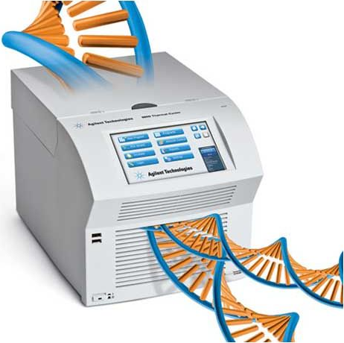

Genome sequencing overview and output
Library preparation by sequencing team at IGB’s Biotechnology Center
1. DNA
Sample fastq file:
@K00363:99:HM3CGBBXX:8:1101:4797:1437 1:N:0:NAAGCTAG+NCATAGCG
ATGCGGAGGTCGAGAACGCGGTTGTCGAGGCGGGTGTCGAGCGCGACCTGGACACCGTCCTCAGCGTCCATGGGGCGGAGGGCCTCGTTGATGGGGAAGG
+
#AAAFAJFAJJAJFFJJJJFFFJJJJJJJJJJJJFJ-F<FAFJFFJ<JAAJFFFJJ<-AA-7<JJF7AFJ-AJJJJF7AFFAF-7AA<<<F7FAF-7A-7
2. Fragmentation
Sequence ID
Sequence
100 bp long
3. Adapter ligation
Quality score (ASCII)
4. Amplification
“Sequencing reads”
5. Sequencing

Slide 9
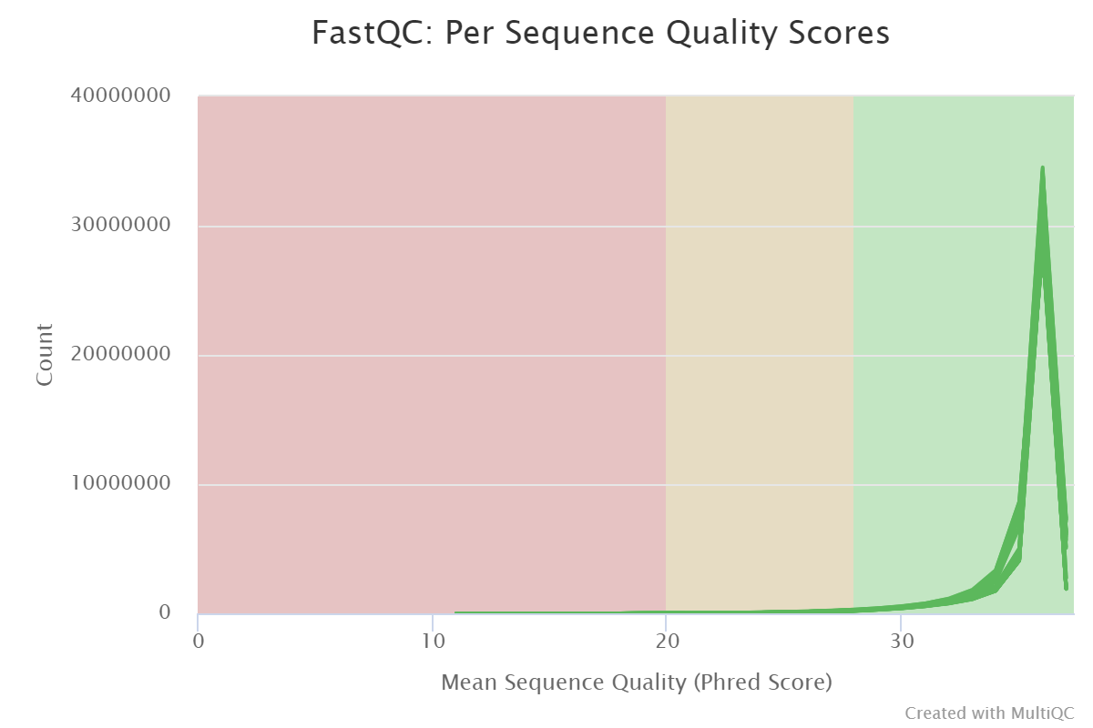
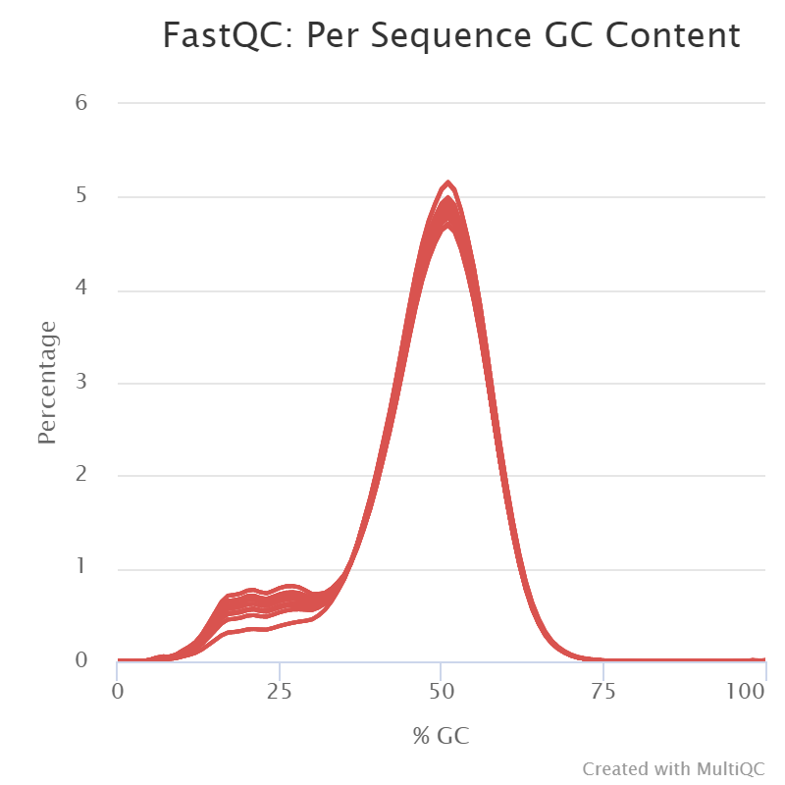
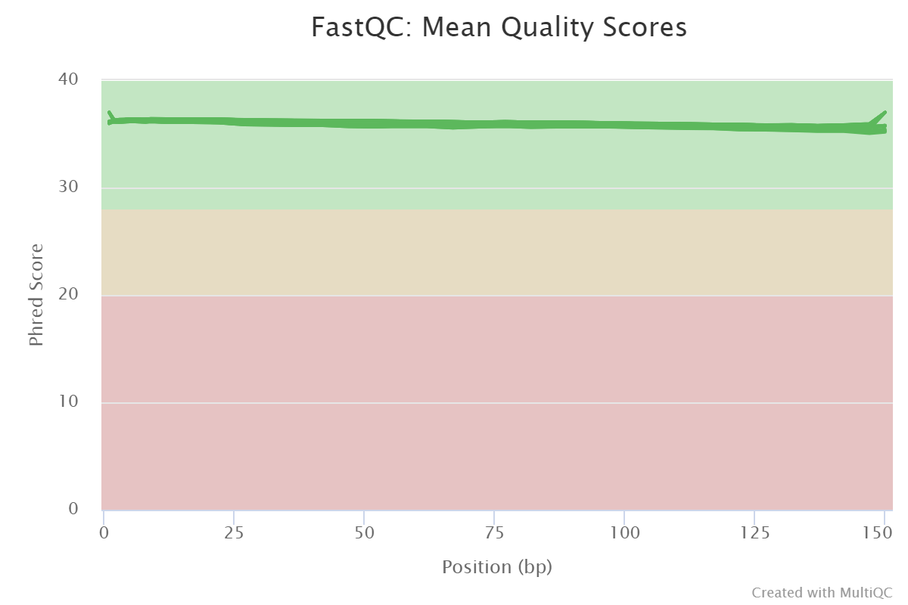
Quality check on trimmed reads

Slide 10


Variant Calling Pipeline
GATK offers “best practices” pipeline suggestions for human cell line analysis
# | Pipeline steps | Module | Functions
0 | Data Cleanup | Trim, FastQC | Trim, FastQC
1 | Genome index and alignment | bwa samtools | bwa-mem view, sort, index
2 | Remove duplicates and sort | gatk | markDuplicates sortSam (by coordinate)
3 | Add read groups, validate SAM | gatk | AddOrReplaceReadGroups ValidateSamFile
4 | Call variants | gatk | HaplotypeCaller
5 | Merge GVCF | gatk | CombineGVCFs GenotypeGVCFs
6 | Hard Filter | gatk | VariantFiltration
7 | Annotation | GenomicRanges GenomicFeatures Rsamtools VariantAnnotation
Pipeline
Align reads
Optimize alignment
Call variants
Filter variants
Annotate

Slide 11
Results - overview
Strain | Description | Read depth | Variants that passed filter | Mutations in a gene
PO1f | Base strain | 369 | 306 | 24
16EV | Evolved from P01f | 386 | 380 | 44
1EV | Evolved from P01f | 349 | 365 | 37
2EV | Evolved from P01f | 343 | 373 | 43
41EV | Evolved from P01f | 319 | 378 | 46
X123 | P01f + xylose pathway | 337 | 326 | 30
XEV | Evolved from X123 | 367 | 340 | 25
GEV | Evolved from XEV | 369 | 311 | 27
In comparison, breseq predicted 2500-3000 mutants

Slide 12
Mutation analysis – excel sheet
Unique mutations in XEV and GEV
Ubiquitin protein ligase RSP5/NEDD4 (PTM)
Unique mutations in XEV
major facilitator superfamily domain-containing protein (yeast polyamine transporter)
Hypothetical protein
Unique mutations in GEV
Cytochrome P450 CYP4/CYP19/CYP26 subfamilies (lipid transport)
Mutations in EV’s but not in PO1f
aspartic peptidase domain-containing protein
bHLH transcription factor Yas2p
P-loop containing nucleoside triphosphate hydrolase protein
Oxysterol-binding protein-domain-containing protein
hypothetical proteins
Strain | Description
PO1f | Base strain
16EV | Evolved from P01f
1EV | Evolved from P01f
2EV | Evolved from P01f
41EV | Evolved from P01f
X123 | P01f + integrated plasmid
XEV | Evolved from X123
GEV | Evolved from XEV

Slide 13
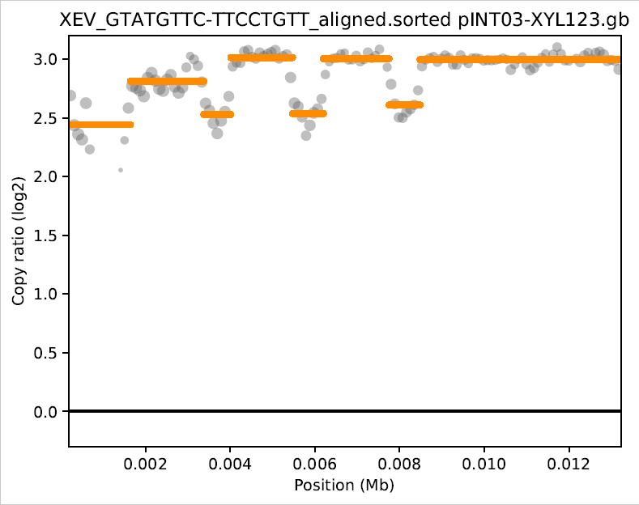
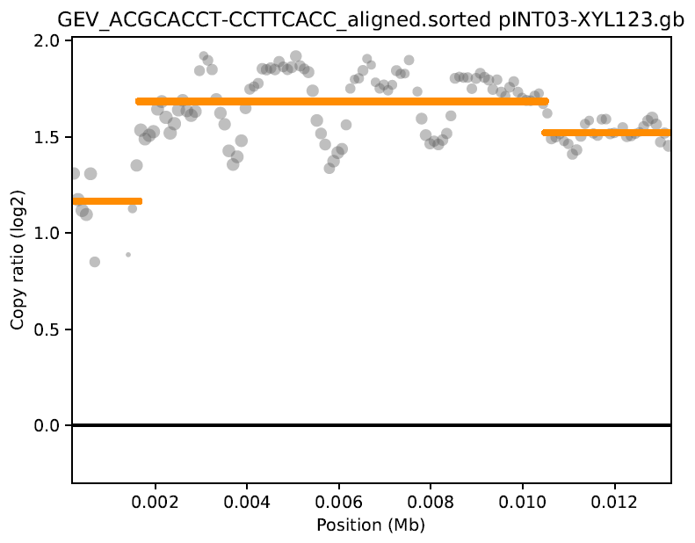
Copy number variation
Analysis using CNVkit pipeline
Median values | Read Depth |  |  | Copy Number
Gene from plasmid | X123 | XEV | GEV | XEV / X123 | GEV / X123 | XEV / GEV
Xyl1 | 789 | 5699 | 2482 | 7.22 | 3.16 | 2.29
Xyl2 | 869 | 5870 | 2535 | 6.78 | 2.91 | 2.32
Xyl3 | 835 | 5716 | 2407 | 6.83 | 2.90 | 2.36
Complete plasmid | 787 | 5428 | 2062 | 6.74 | 2.77 | 2.31
Analysis using read depth

